Slide 1
SOFTWARE DEVELOPEMNT Lecture # 02
Engr. Rahemeen
Sr. Lecturer
Software Engineering Department

Slide 2
Objective
A Generic Process Model
Process Patterns
Process Assessment and Improvement
Summary

Slide 3
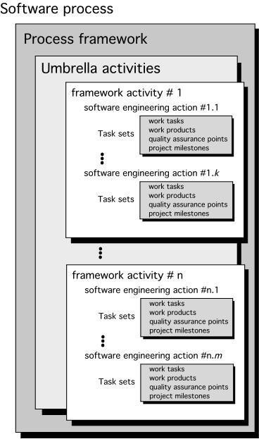
A Generic process Model
Traditional methodology for developing, maintaining, and replacing information systems is known as SDLC.
Phases in SDLC:
Planning
Analysis
Design
Implementation
Maintenance

Slide 4
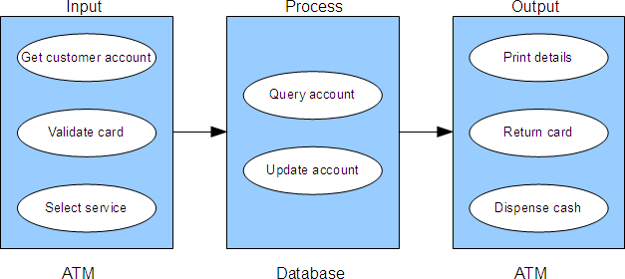
Types of Information System
Transaction Processing Systems (TPS)
Automate handling of data about business activities (transactions)
Process orientation

Slide 5
Types of Information System
Management Information Systems (MIS)
A management information system (MIS) is an information system used for decision-making, and for the coordination, control, analysis, and visualization of information in an organization.
The study of the management information systems involves people, processes and technology in an organizational context.
Example Human Resource Management System.
An MIS report meaning a report that management prepares work differently from one business to the next. Reports may be drafted:
Weekly
Monthly
Quarterly

Slide 6
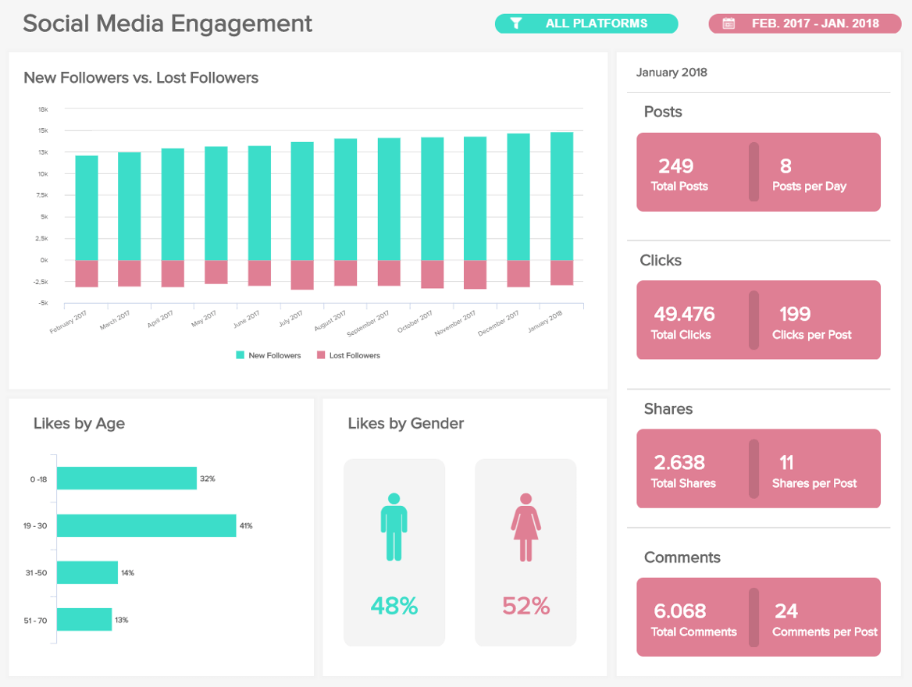

Slide 7
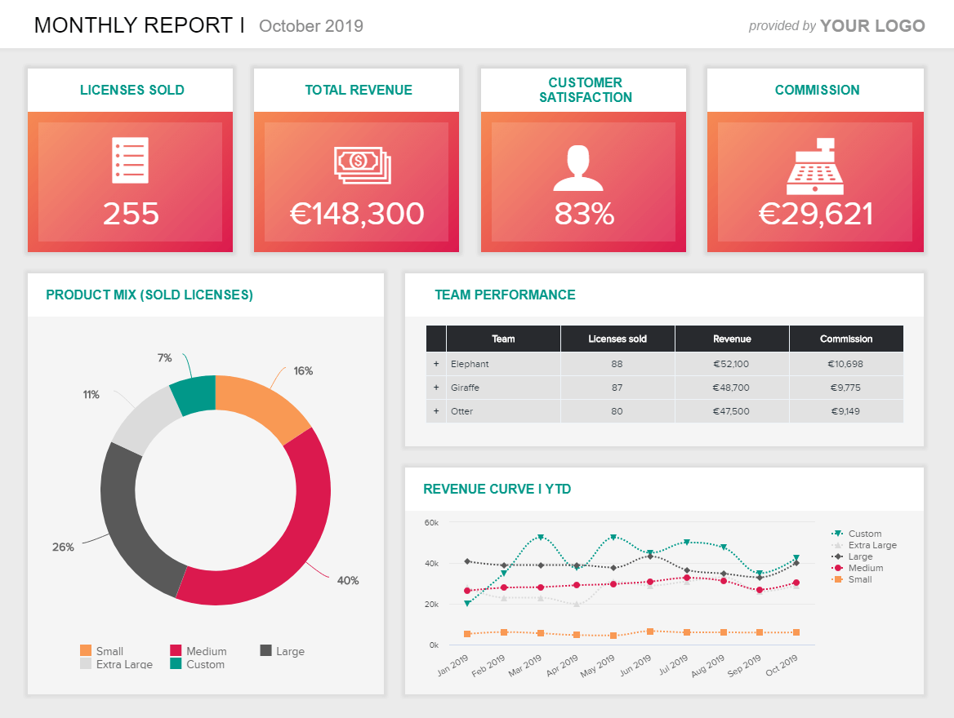

Slide 8
Types of Information System
Decision Support Systems (DSS)
A decision support system (DSS) saves time and increases confidence during business decision-making. When you use a DSS, you benefit from its data analysis and ability to identify patterns.
These are some other uses of DSS, including:
Agriculture: Farmers use DSS tools for crop planning to help them determine the best times for planting, fertilization and harvesting.
Weather forecasting: Some states use DSSs to provide information about potential future hazards such as floods.
Medicine: Clinical DSS technology has many uses.

Slide 9
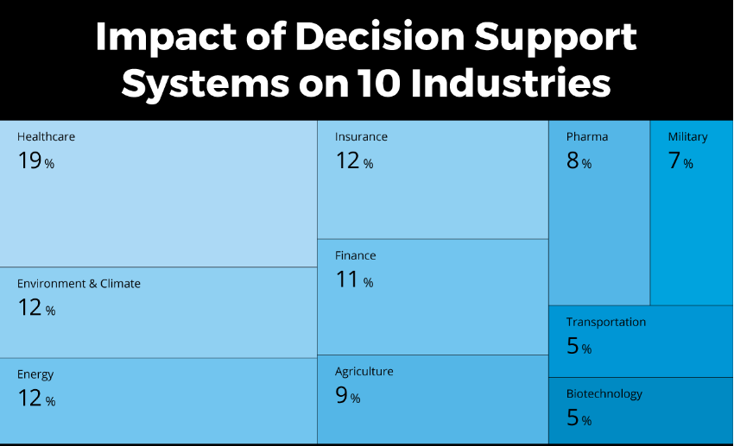

Slide 10
Identifying a Task Set
A task set defines the actual work to be done to accomplish the objectives of a software engineering action.
It consists,
A list of the task to be accomplished
A list of the work products to be produced
A list of the quality assurance filters to be applied

Slide 11
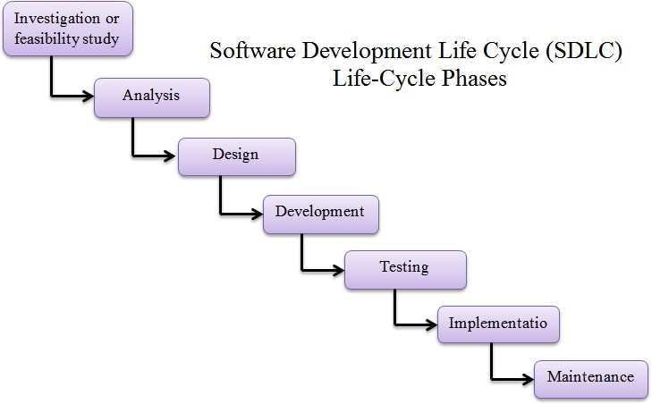
Systems Analysis and Design Life Cycle (SDLC)

Slide 12
SDLC Phase 1: Investigation or feasibility study:
The feasibility study of project is a developing sometimes used to present the project to upper management in a attempt to gain funding. A project is typically evaluated in three areas of feasibility studies;
▷ Economical feasibility study
▷ Operational feasibility study
▷ Technical feasibility study

Slide 13

SDLC Phase 2: Analysis
▷ The next phase of lifecycle is analysis the customer problem and how to fix the customer requirement to solve the problem in best optimal way.
▷ This phase involves breaking down the system in different pieces and drawing diagrams to analyze
the situations.

Slide 14
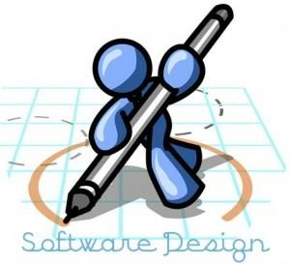
SDLC Phase 3: Design
▷ Third phase of software life cycle is design, it includes design blueprint of the developing system. It is done by designing the technical architecture of the system.
▷ This phase includes designing the system model in GUI format, database design to placement of
objects on GUI screen.

Slide 15
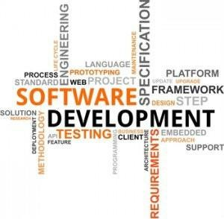
SDLC Phase 4: Development
▷ Forth phase is development or code generation as per the user/customer requirement.
▷ This phase takes the design phase output and translated it into machine readable form, this translation done by using code generation.

Slide 16

SDLC Phase 5: Testing
▷ The generated code in the development phase is tested at various levels in the software testing.
▷ This phase is responsible to finding defects and bugs in the created code in previous phase of SDLC.

Slide 17

SDLC Phase 6: Implementation
▷ The systems are placed and used in the actual environment and the user guide is created, training is provided to the users of the system.

Slide 18
SDLC Phase 7: Maintenance
▷ The next phase of SDLC is maintenance of created software.
▷ The software will definitely undergo change once it is delivered to the customer. There can be many reasons for this change to occur.
▷ Change could happen because of some unexpected input values into the system.

Slide 19
Process Patterns
A process pattern
describes a process-related problem that is encountered during software engineering work,
identifies the environment in which the
problem has been encountered, and
suggests one or more proven solutions to the problem.

Slide 20
Process Pattern Types
Stage patterns—defines a problem associated with a framework activity for the process.
Task patterns—defines a problem associated with a software engineering action or work task and relevant to successful software engineering practice
Phase patterns—define the sequence of framework activities that occur with the process, even when the overall flow of activities is iterative in nature.

Slide 21
Software process descriptions
When we describe and discuss processes, we usually talk about the activities in these processes such as specifying a data model, designing a user interface, etc. and the ordering of these activities.
Process descriptions may also include:
–Products, which are the outcomes of a process activity;
–Roles, which reflect the responsibilities of the people involved in the process;
–Pre- and post-conditions, which are statements that are true before and
after a process activity has been enacted
or a product produced.

Slide 22
Plan-driven and agile processes
Plan-driven processes are processes where all of the process activities are planned in advance and progress is measured against this plan.
In agile processes, planning is incremental and it is easier to change the process to reflect changing customer requirements.
In practice, most practical processes include elements of both plan-driven and agile approaches.
There are no right or wrong software processes.

Slide 23




The people involved with software
The following are software "stakeholders", i.e., people who have some interest in a software product and/or its development
end users -- people who will use the software or people who represent those who will use it
customers -- people who purchase the software, which
they may or may use themselves

Slide 24
The people involved with software
domain experts -- people who fully understand the application domain in which the software will run
analysts -- members of the software development staff who specialize in requirements analysis and specification
implementers -- members of the development staff who specialize in software design and implementation
testers -- members of the development staff and user community who test the software to ensure that it meets the requirements specification

Slide 25
The people involved with software
managers -- those who manage the development process, as well as those who manage end users when the software is
installed in an organization
visionaries -- those who have the "big picture" for what the software is intended to do and how it will be developed
maintainers and operators -- those who conduct post- development maintenance and operations, as necessary
other interested parties -- anyone else interested in the software product, such as those with a financial investment

Slide 26
Q/A

